Slide 1
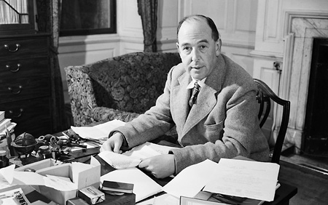
Team C.S. Lewis
OOP Team work assignment:
“WarChess” RPG game
Team members:
Veselin Dimitrov veselin.dimitrov.1848
Yanko Tsigularov Tsigularov
Kristiyan Petrov kris4o1993
Ivan Danchev INavy
Georgi Yanakiev m3tr0n0m3
Georgi Yakimov Santyago
Telerik Software Academy
http://academy.telerik.com

Slide 2
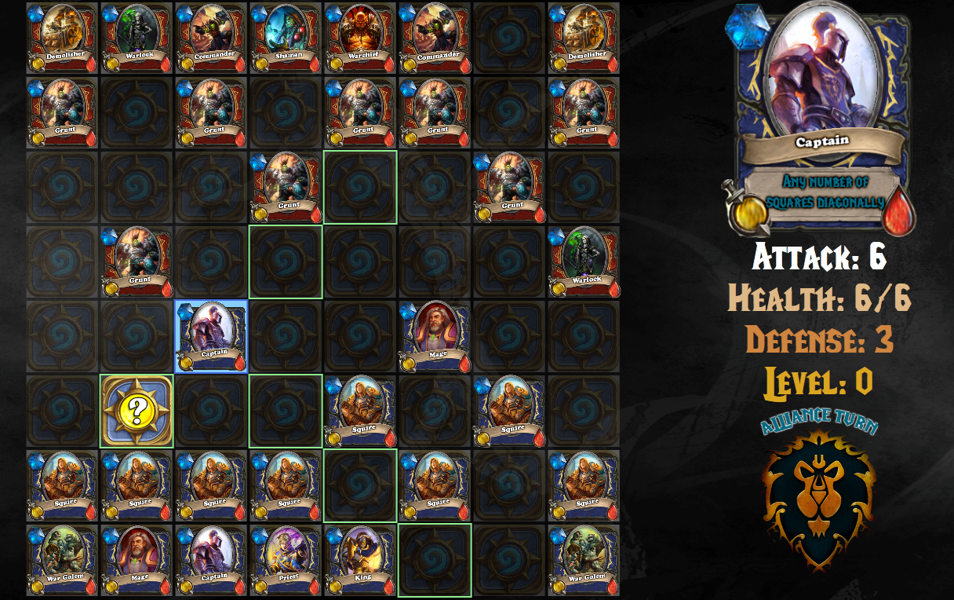
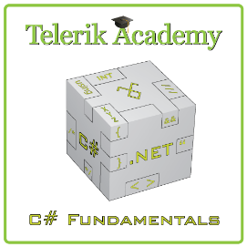
Gameplay
Main goals
Kill all enemy units
Collect secrets
Game over
When all team units or the most important are dead

Slide 3

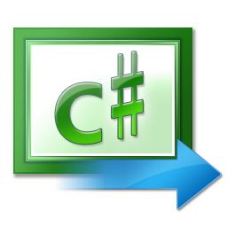


Game design and Implementation
Used XAML technology
for implementation of the graphical interface.

Slide 4
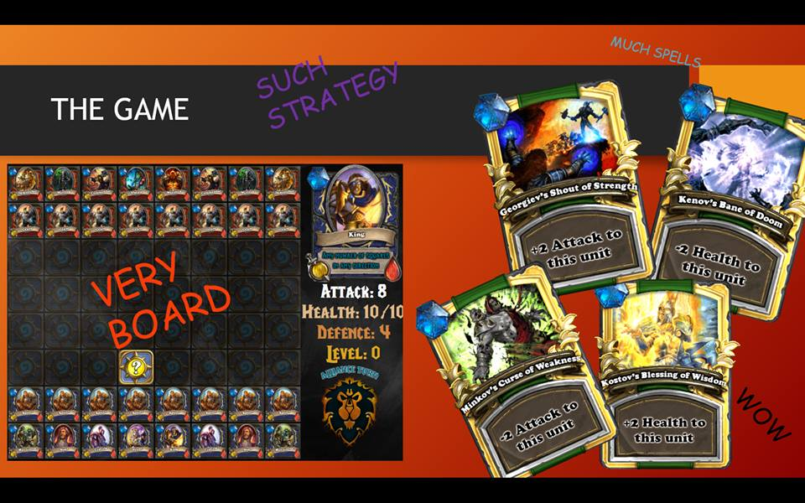
Live Demo

Slide 5


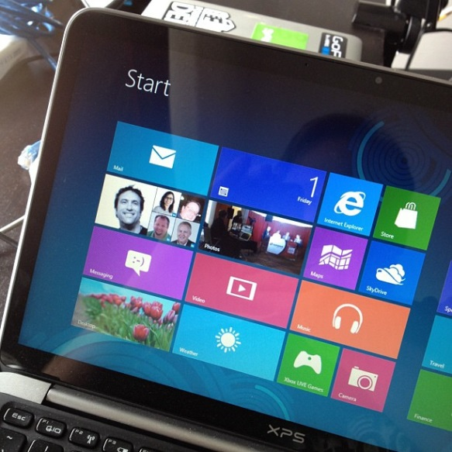

Questions ?
?
?
?
?

